Slide 1
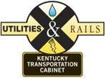
Railroad Session Railroad Acquisition, Crossings, etc.
September 5, 2018
Allen Rust, PE
Rail Coordinator
KYTC
Division of Right of Way and Utilities

Slide 2
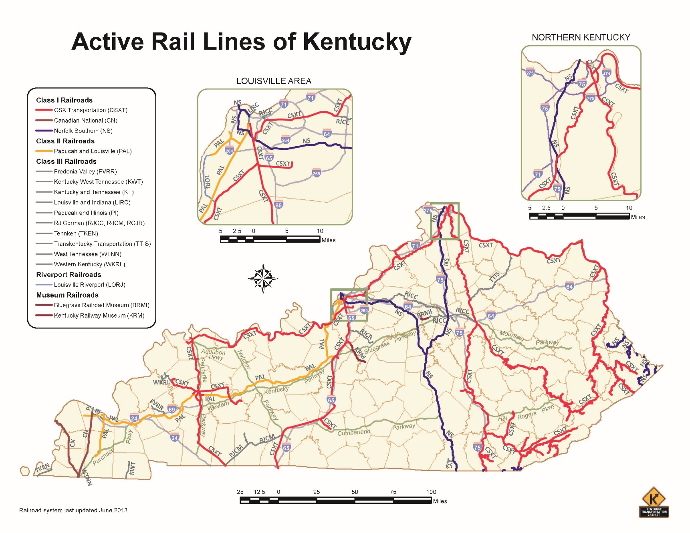
Railroads in Kentucky

Slide 3
Railroads in Kentucky
Railroad | Miles of Track in KY
CSX | 1,685
Norfolk Southern | 429
Paducah and Louisville | 280
RJ Corman | 197
Illinois Central | 98
TTI | 50
Others | 452
Total: 3,191 miles

Slide 4
Railroad Acquisitions
How the process works
RR specific requirements
Railroad Agreements
Plan reviews
Agreement drafting and execution
Railroad Crossings overview
Questions

Slide 5
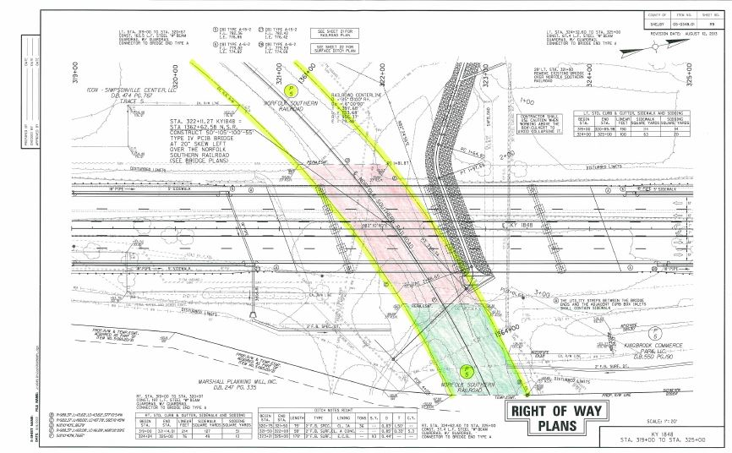
Right of Way
Offer
Offer to Purchase
MAR/Valuation
MOU
Plan Sheets
Deed Description
PDF and Word

Slide 6
Railroad Requirements
CSX
Aerial easements
License Agreements for culverts in lieu of Permanent Easements
Norfolk Southern
Recordable Plat
Description with signed Surveyor’s stamp
All corners marked with State Plane Coordinates
CNO&TP parcels must go before Board of Trusstees
Paducah and Louisville
May be able to use Right of Entry agreement in lieu of Easement
RJ Corman
Some ROW owned by CSX

Slide 7
When to make RR offer
ASAP
6 months to 2 years
Large impact by heavy turnover at RRs
Special cases

Slide 8
Right of Way
Receive executed deed and MOU
Submit Payment request and send to RR
Forward deed to District for recording

Slide 9
Railroad Coordination
Acquire Right of Way
Coordinate plan review with RR companies
Coordinate flagging to protect RR facilities
Ensure that Cabinet contractors perform to standards

Slide 10
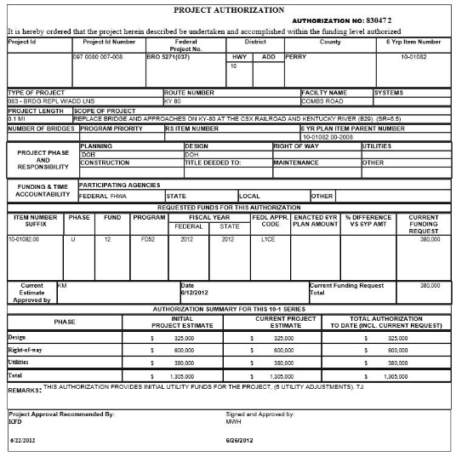
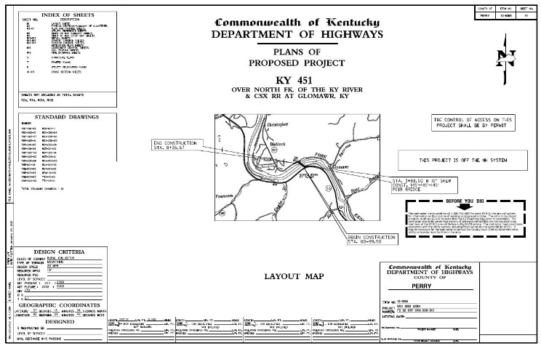
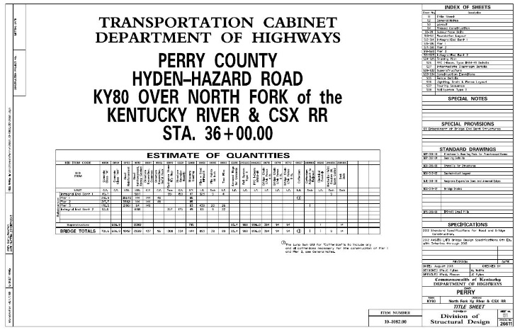
Initial Submittal
Funding
Primarily U
Can use D or C
Preliminary Road Plans
Preliminary Structure Plans

Slide 11
Comments Exchange
Railroad returns comments
Designers address comments
May impact ROW
Send revised plans to RR

Slide 12
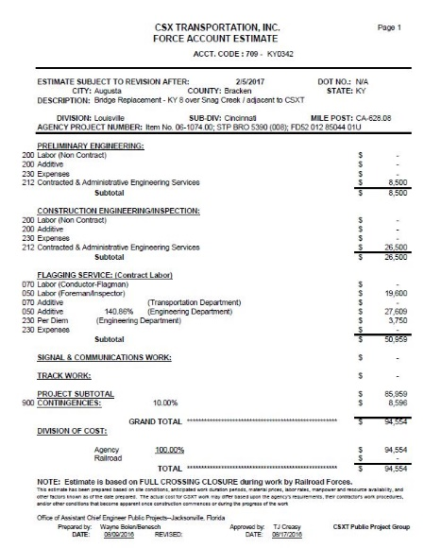
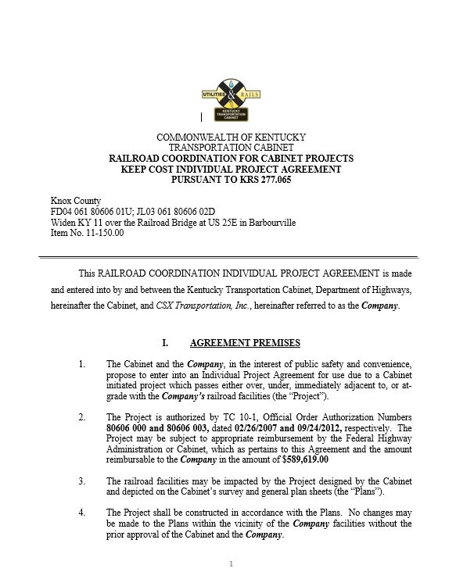
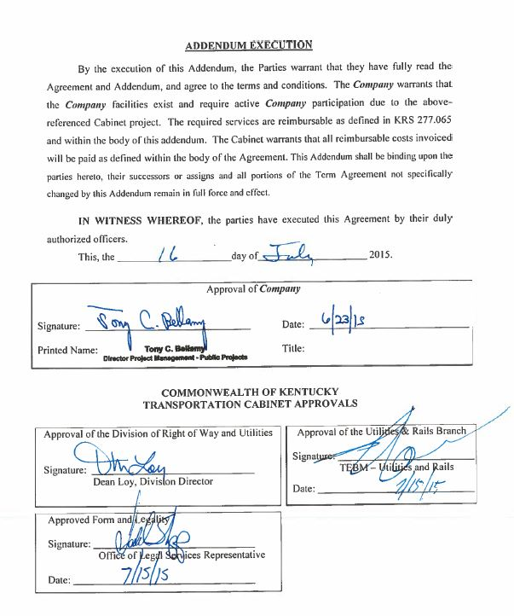
Agreement
Force Account Estimate (FAE)
Draft Agreement
Execution

Slide 13
Agreement (cont.)
Housed in KURTS
Available upon request
RR won’t execute deed until Agreement Executed

Slide 14
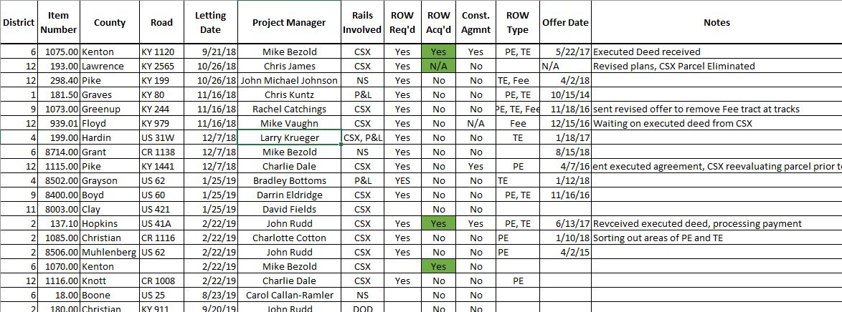
Communication
Rail Coordination Update
Rail Coordination Status Report
Rail ROW Status Report

Slide 15
Crossings
2,106 Open, Public, At-Grade Crossings

Slide 16
Crossings
Rail Crossing Inventory (RCI)
Section 130 Program
RRs must maintain crossings

Slide 17
Questions?
Allen Rust, PE
Rail Coordinator
KYTC
Allen.Rust@KY.gov
502-782-4950

Slide 18
Crowdcompass Attendeehub App
Search 2018Partnering

